Slide 1
Dark energy: the greatest mystery of the universe
Syksy Räsänen
Department of Physics and
Helsinki Institute of Physics

Slide 2
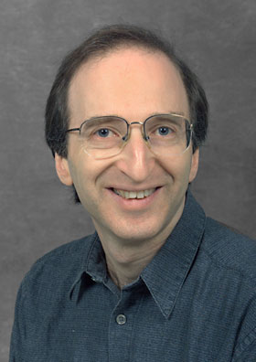
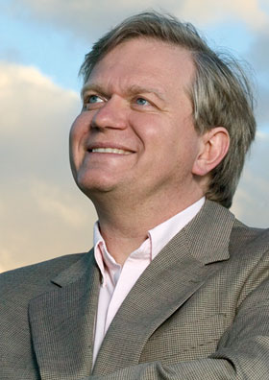
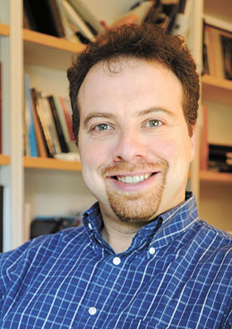
Physics Nobel prize 2011
“for the discovery of the accelerating expansion of the Universe through observations of distant supernovae”
Saul Perlmutter
Brian P. Schmidt
Adam G. Riess

Slide 3
From brightness to darkness
Observation: Distances are longer than expected.
Interpretation: Expansion of the universe has accelerated.
Cause: Dark energy.

Slide 4
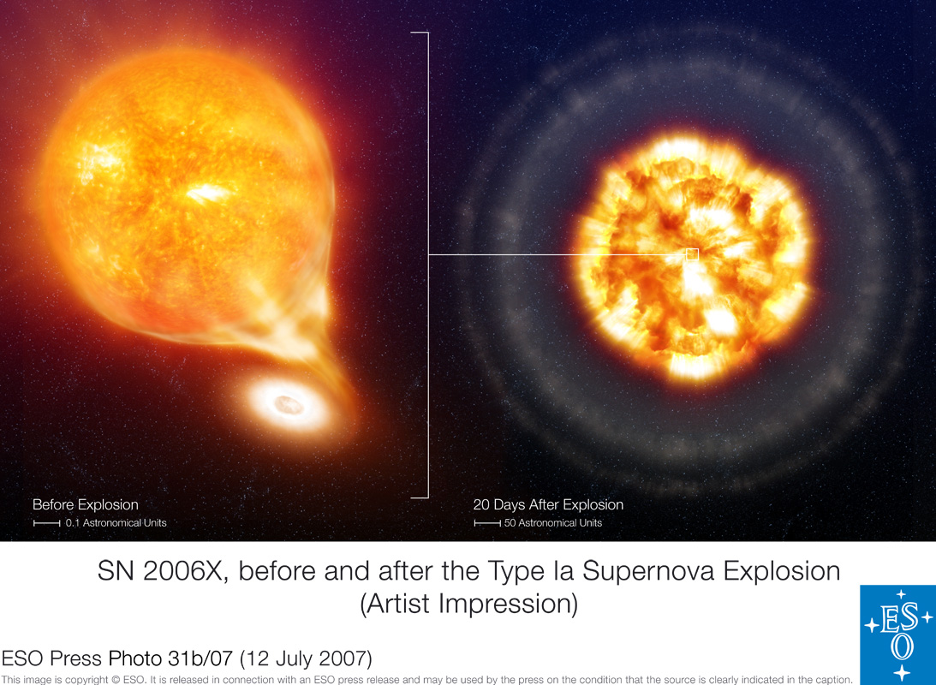
Type Ia supernova

Slide 5
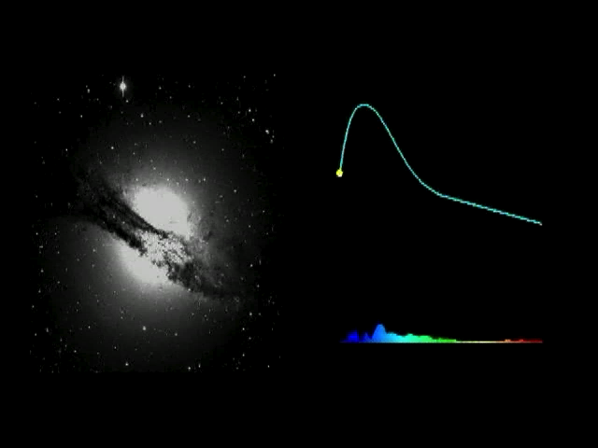
Type Ia supernova

Slide 6
From astrophysics to cosmology
Supernovae are dimmer.
Exclude scattering from dust, evolution, and so on ⇒ supernovae are further away
How to relate distance to expansion rate?
The result is unexpected, so should be careful with assumptions.

Slide 8
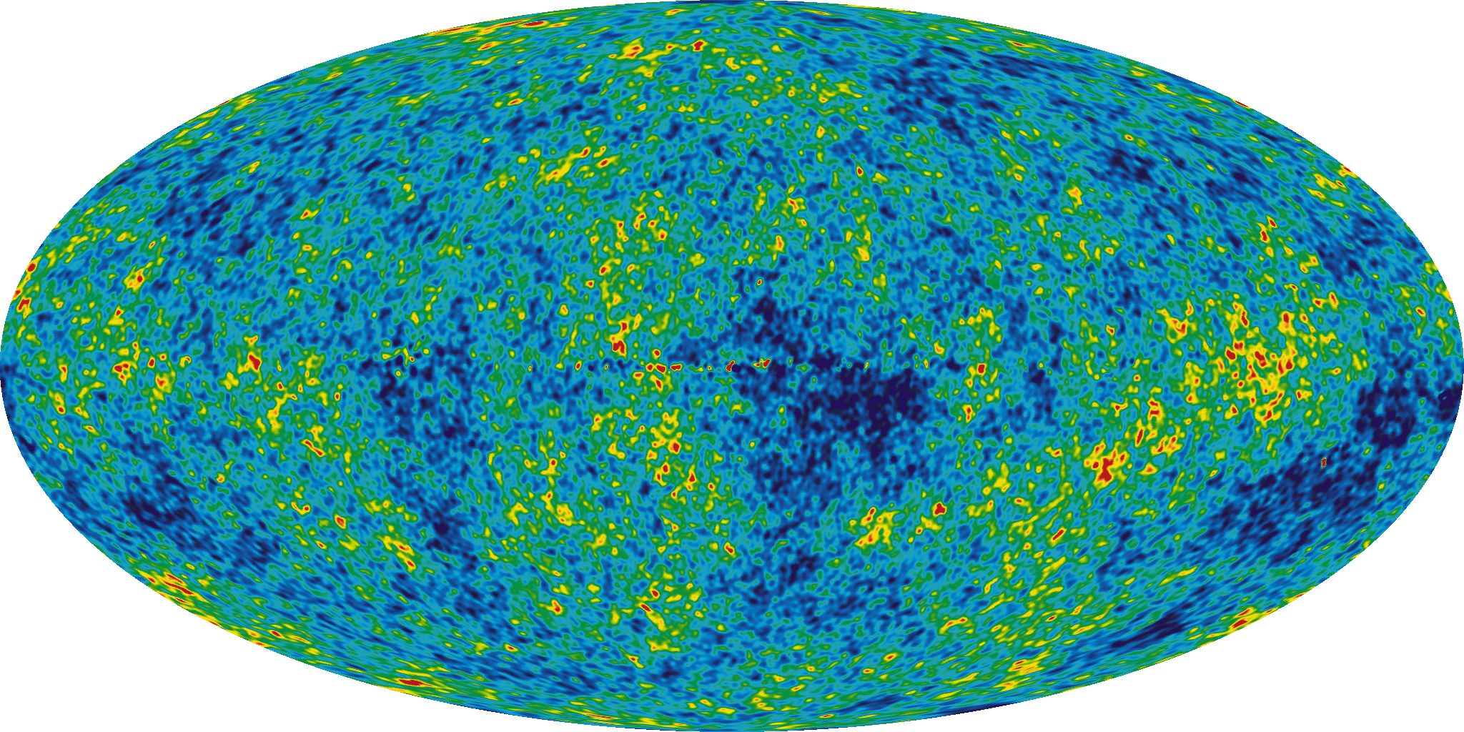
WMAP 2003
http://map.gsfc.nasa.gov/

Slide 9
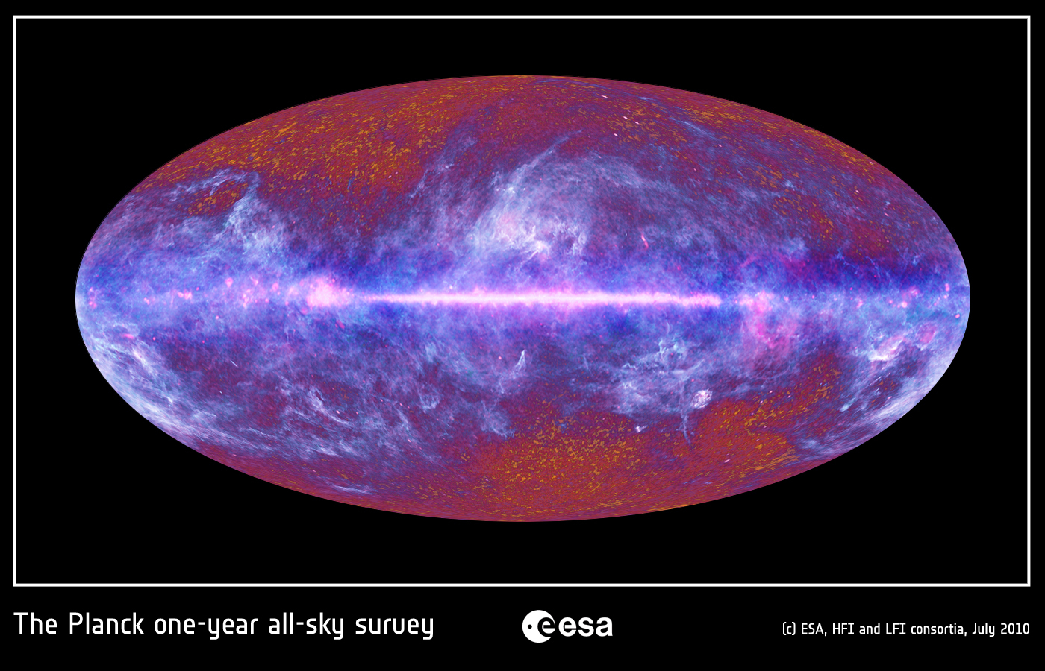
Planck 2010
http://sci.esa.int/science-e/www/object/index.cfm?fobjectid=47333

Slide 10
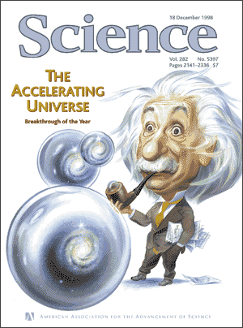

Slide 11
Assumptions
General relativity is valid.
  The universe is a four-dimensional curved spacetime.
  The relation between curvature and matter is determined by the Einstein equation.
Space is exactly homogeneous and isotropic.

Slide 12
The Friedmann-Lemaître-
Robertson-Walker model
Assumptions 1.1 (spacetime) and 2 (symmetry) lead to a relation between distance and expansion rate.
It follows that the longer distances imply faster (in fact accelerated) expansion.
Adding assumption 1.2 (dynamics) leads to the conclusion that there is matter with negative pressure.

Slide 13
Dark energy
Dark energy is a form of matter which has negative pressure, does not absorb or emit light and which is evenly spread in the universe.
Not to be confused with dark matter, which has positive pressure and is clumped.

Slide 14
Vacuum energy
Best candidate for dark energy: vacuum energy/cosmological constant.
In quantum field theory, there is energy associated with empty space. This fits the observations well. (Some issues with galaxy distribution remain.)
Main problems with vacuum energy are theoretical.

Slide 15
Problems with vacuum energy
Why is the vacuum energy density so small?
Why is the vacuum energy density so close to the matter energy density today? (“the coincidence problem”)

Slide 16
The smallness problem
Naive theoretical estimate of vacuum energy density:
Value which fits the observations:
A mismatch of 10⁻¹²⁰.
“The worst prediction in all of theoretical physics.”

Slide 17
The coincidence problem
Vacuum energy density stays constant.
In contrast, as the universe expands, the energy density of matter drops inversely to the volume.
Today, .
Why are we living in a special era? Why 10 billion years?

Slide 18
Models of dark energy
Vacuum energy is the simplest model of dark energy.
Dozens of different alternatives have been studied.
Could be a field permeating all of space, quintessence.
A common problem: why 10 billion years?

Slide 19
Three alternatives
Recall: if we assume general relativity + homogeneity & isotropy, dark energy is needed.
What if general relativity needs to be modified?
What if the approximation of neglecting structures is not valid?

Slide 20
Modified gravity
We can either drop the Einstein equation or the four-dimensional spacetime, or both.
However, general relativity has been well tested.
The simplest modification, the cosmological constant, is equivalent to vacuum energy.
Also: why 10 billion years?

Slide 21
Effect of structures
We can drop the approximation of perfect homogeneity and isotropy.
This changes both the relationship between distance and expansion rate, as well as the expansion rate.
  Expansion can accelerate without negative pressure.
  Distances can be longer without acceleration.
Structure formation has a time scale of 10 billion years.
No realistic models yet.

Slide 22
Questions remain
Distance observations show that something strange is going on.
Vacuum energy fits the observations, but makes people uneasy.
Dark energy, modified gravity, the effect of structures?
Nobel committee: “dark energy [...] is an enigma, perhaps the greatest in physics today”

Slide 23
On the history and future of gravity
Tieteiden talo ti 8.11. kello 18: ”Kuun alta kaarevaan avaruuteen”

