Slide 1
Historical linguistics, sociolinguistics, and linguistic geography: language evolution at the Siberian North
Olesya Khanina
University of Helsinki & Finno-Ugrian Society & Institute of Linguistics RAS
olesya.khanina@helsinki.fi, olesya.khanina@gmail.com

Slide 2
Outline
Aims of my research
Incl. the theoretical framework
My approaches: data & methods
Collaborators, funding

Slide 3
Aims of my research
To reconstruct the details of evolution of Northern Samoyedic languages (the reaches of the Lower Yenisei river; 2000 years).
Northern Samoyedic < Samoyedic < Uralic

Slide 4
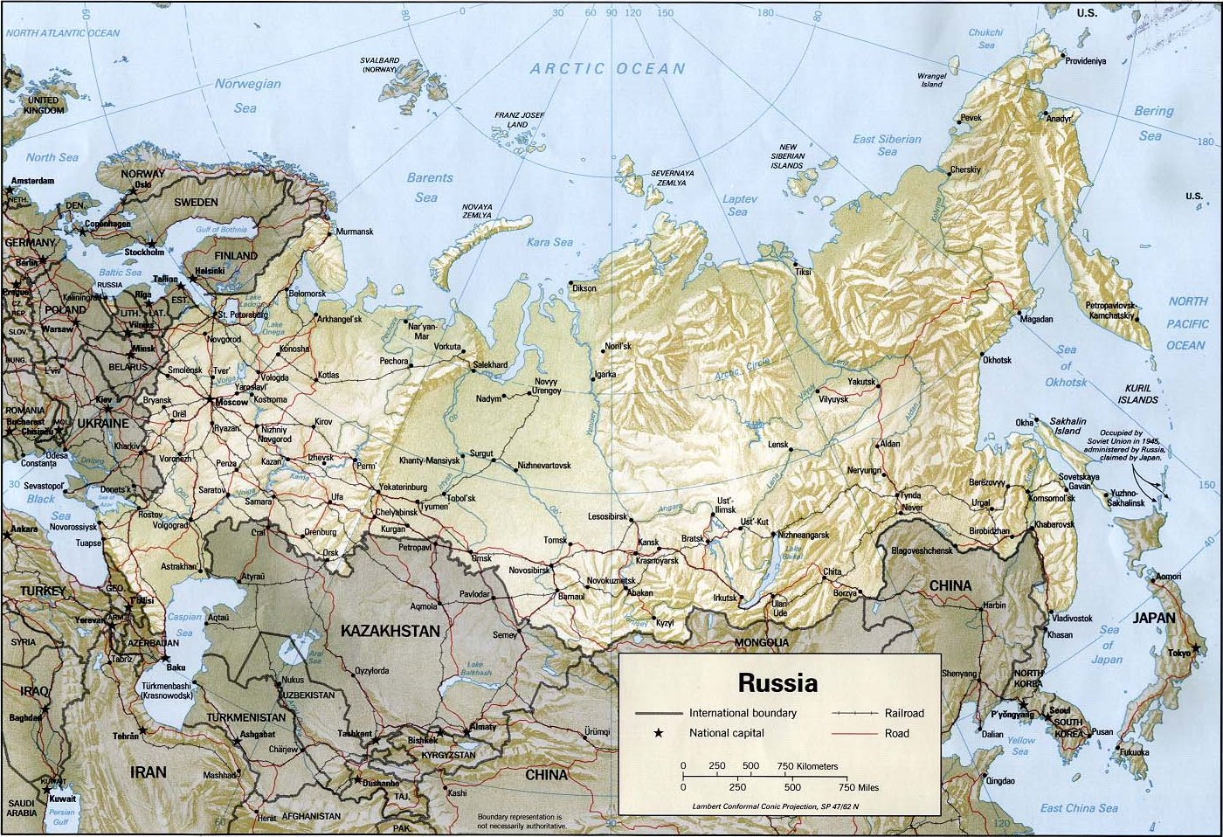
Introduction to the area: Lower Yenisei

Slide 5
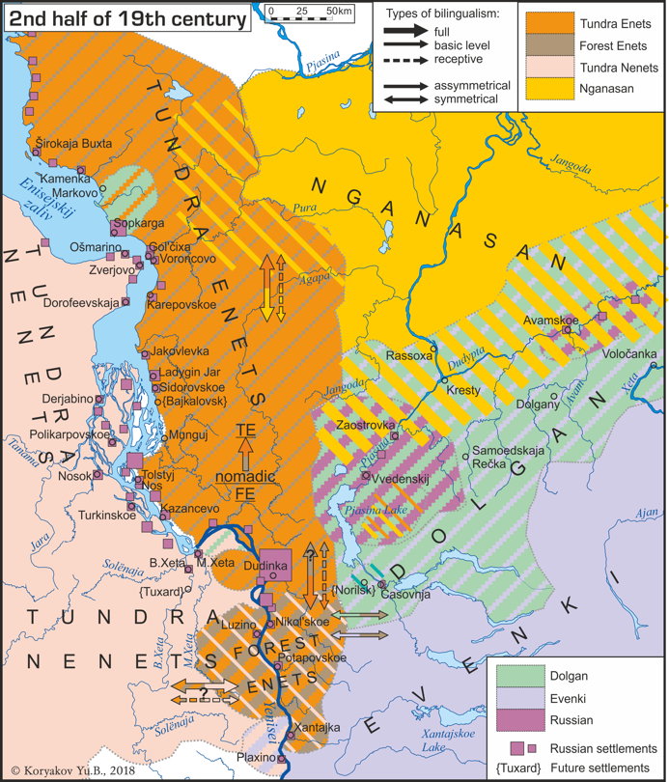
Aims of my research
To reconstruct the details of evolution of Northern Samoyedic languages (the Lower Yenisei river; 2000 years).
Within a larger frame of interactions between
all historic processes: genetic, geographic, social, and linguistic.

Slide 6
Theoretical framework
Historical linguistics, broadly understood
(Heggarty 2015): «What determines the (pre)histories of language lineages, and shapes how they relate to each other, are just the real-world contexts that impacted upon the populations that spoke them <…> real-world contexts dictate not so much which particular changes occur, but which patterns of divergence may emerge from any changes».
Diachronic typology: how and why languages diversify and spread
In particular, a complex interplay of horizontal and vertical transmission, centripetal and centrifugal forces in language evolution.
recent studies where attention paid both to linguistic and social factors: Evans 2018, 2019, François 2011, Rumsey 2018

Slide 7
Approaches: linguistics
Historical linguistics: a study of Northern Samoyedic isoglosses, complemented by a study of 18-19th cent. records of these languages, a study of substrate features
Data: field data, published grammars & dictionaries, corpora, manuscripts from the 18th (Miller) and the 19th (Castrén) centuries, typological observations on what is common/rare, etc.
Linguistic geography: a study of geographic distribution and migrations, including geospatial modelling
Data: archival records, state censuses, travelers’ records, isoglosses from (1), unified comparative wordlists, etc.
Sociolinguistics: a retrospective study of multilingualism & language ideologies (before the massive shift to Russian ca. 50 y.a.), language shifts
Data: retrospective sociolinguistic interviews, state censuses, narratives collected in the early 20th cent., ethnographic works, ethnonyms, etc.

Slide 8
Approaches: beyond linguistics
Genetics: population movements and replacements (e.g. Pugach et al. 2016, Sikora et al. 2019, Tambets et al. 2018, Lamnidis et al. 2018, Flegontov et al. 2016, 2019)
Data: modern DNA (quite extensive), ancient DNA (yet very limited)
Archeology: cultural artefacts
Data: very few sites yet discovered
Paleoecology: ecological changes that have conditioned population movements (climate, forestation, etc.)
Historical ethology: emergence and development of reindeer herding that conditioned a large part of migrations.
…

Slide 9
Languages of the Lower Yenisei

Slide 10
Collaborators, funding
Olesya Khanina (UH & Moscow): sociolinguistics, typology, Forest Enets, Tundra Enets
Valentin Gusev (Hamburg & Moscow & UH): historical linguistics, typology, Nganasan, non-Samoyedic languages of the area
Maria Amelina (Moscow): Tundra Nenets
Yuri Koryakov (Moscow & UH): linguistic geography
Kaj Syrjänen (Tampere & Turku): computational approaches
Research Center for Cultural and Biological Diversity (University of Turku, University of Tartu) - BEDLAN, URKO, SUGRIGE: computational approaches, geospatial modelling, genetics
Irina Pugach & Brigitte Pakendorf (Leipzig & Lyon): genetics
2017-2021: Russian Science Foundation at the Institute of Linguistics (Moscow),
2020-2021: Kordelin foundation at the Finno-Ugrian Society (Helsinki),
2021-2025: Kone foundation at the University of Helsinki.

